Slide 1

Java ObjectOutputStream Class
The ObjectOutputStream class is used to write primitive data types and Java objects to an OutputStream. Only objects that support the java.io.Serializable interface can be written to streams.
The Java ObjectOutputStream class enables you to write Java objects to an OutputStream instead of just raw bytes. You wrap an OutputStream in a ObjectOutputStream and then you can write objects to it.
The Java ObjectOutputStream is often used together with a Java ObjectInputStream. The ObjectOutputStream is used to write the Java objects, and the ObjectInputStream is used to read the objects again.
PrintStream
OutputStream(i.e FileOutputStream)
ObjectOutputStream
Java Application
Write
Write

Slide 2
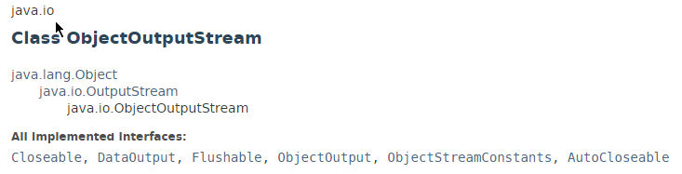
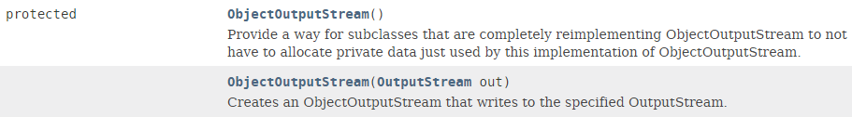
Java ObjectOutputStream Class

Slide 3
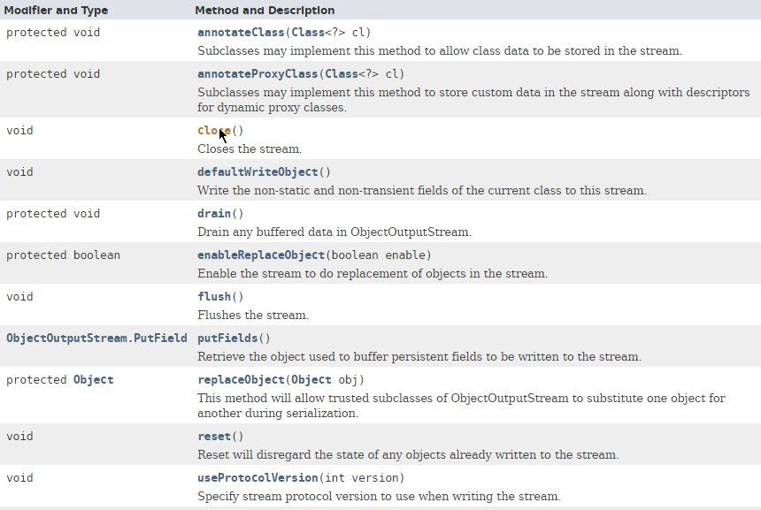
Java ObjectOutputStream Class

Slide 4
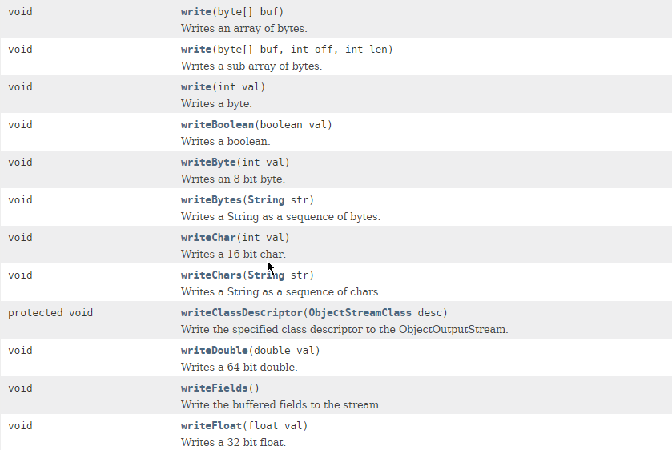
Java ObjectOutputStream Class

Slide 5
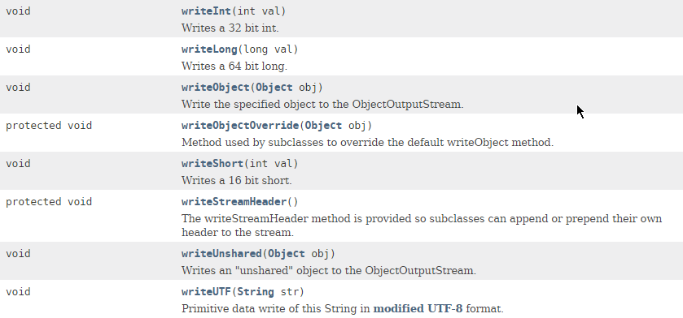
Java ObjectOutputStream Class

Slide 6
Java ObjectOutputStream Class
https://docs.oracle.com/javase/8/docs/api/index.html?java/io/ObjectOutputStream.html

